Slide 1
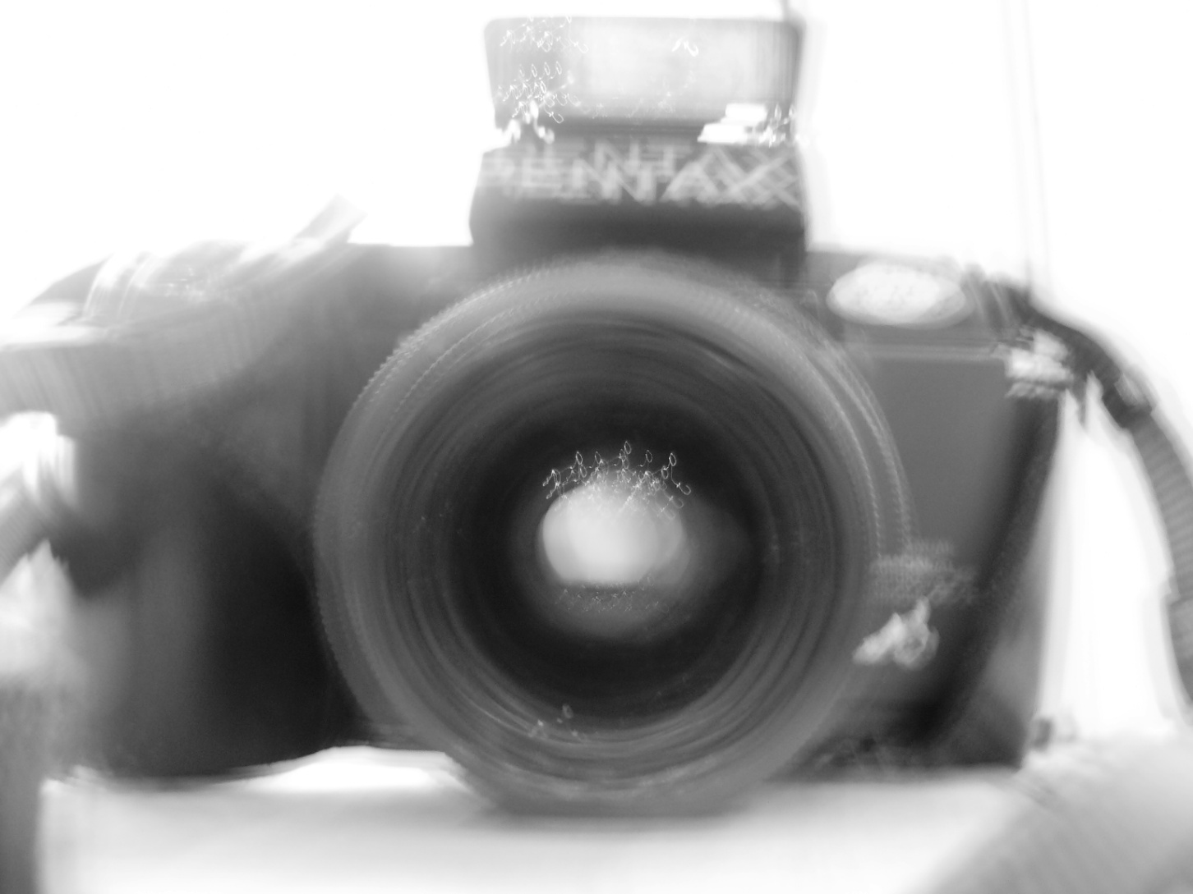
photography

Slide 2
I set myself a brief: to collate a series of photographs illustrating ‘travel’. I have tried to include photographs which encompass all aspects of the word’s meaning.
All of the following photos were taken while travelling: either in transit (in a car, boat, or train) or while in another country (includes Spain, France and India).
The majority of the photographs have been taken for this portfolio. Some had been taken a few years previously, but I included them because fitted the brief and worked well with the other photographs.
I have used a range of techniques to create these photographs: I have used a slow shutter speed to blur the photograph and create a more direct impression of movement. I have adjusted the aperture to control the depth. I have learnt to balance the settings on my camera to create the best photograph I can and to make use of the light I am photographing in.
I have also concentrated on my compositional skill, trying different angles to create interesting shapes and light effects.
By taking photographs from a moving car I was able to practice looking into the distance to find a good shot so that I was able to capture the image I wanted in time. This is particularly true in slide 14 where I made sure to capture the shape of the tunnel, the light shining through, the windscreen wipers of the car, the station sign and the landscape beyond.
    Contains 33 photographs

Slide 3
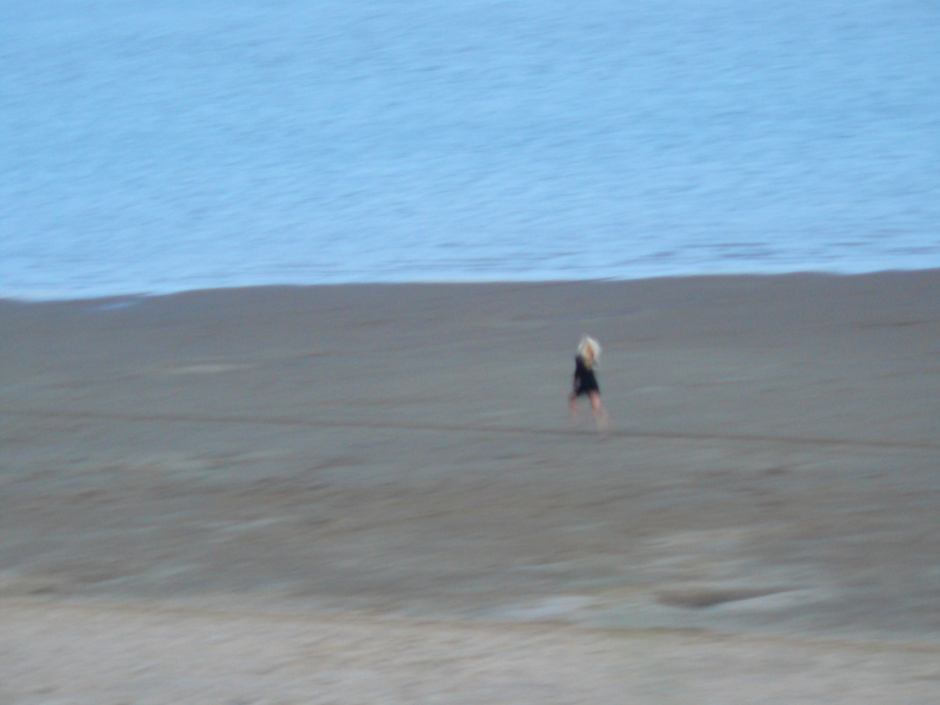
focal length 41.3mm, f3.3, shutter 1/8, exposure compensation 0

Slide 4
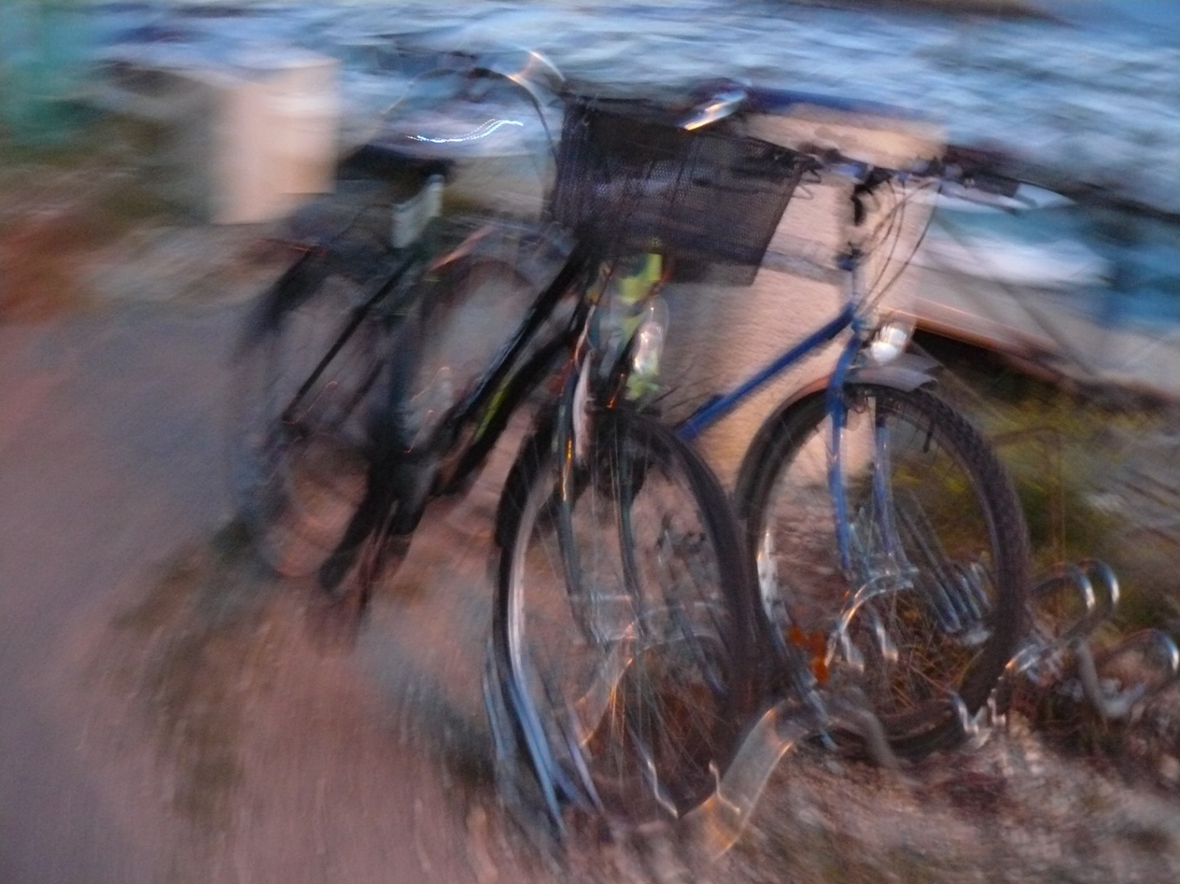
focal length 6.4mm, f2.8, shutter 2/5, exposure compensation 0

Slide 5
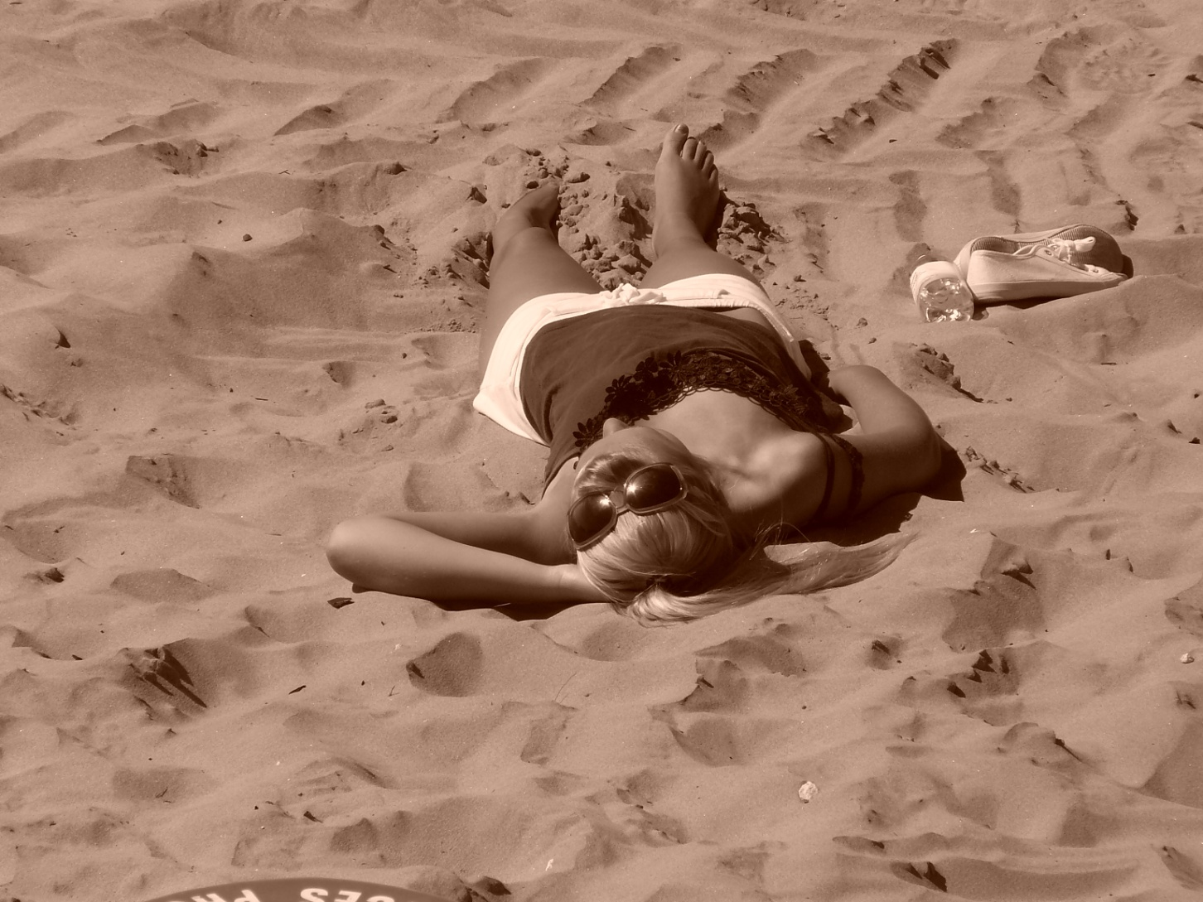
focal length 51mm, f8, shutter 1/500, exposure compensation 0

Slide 6
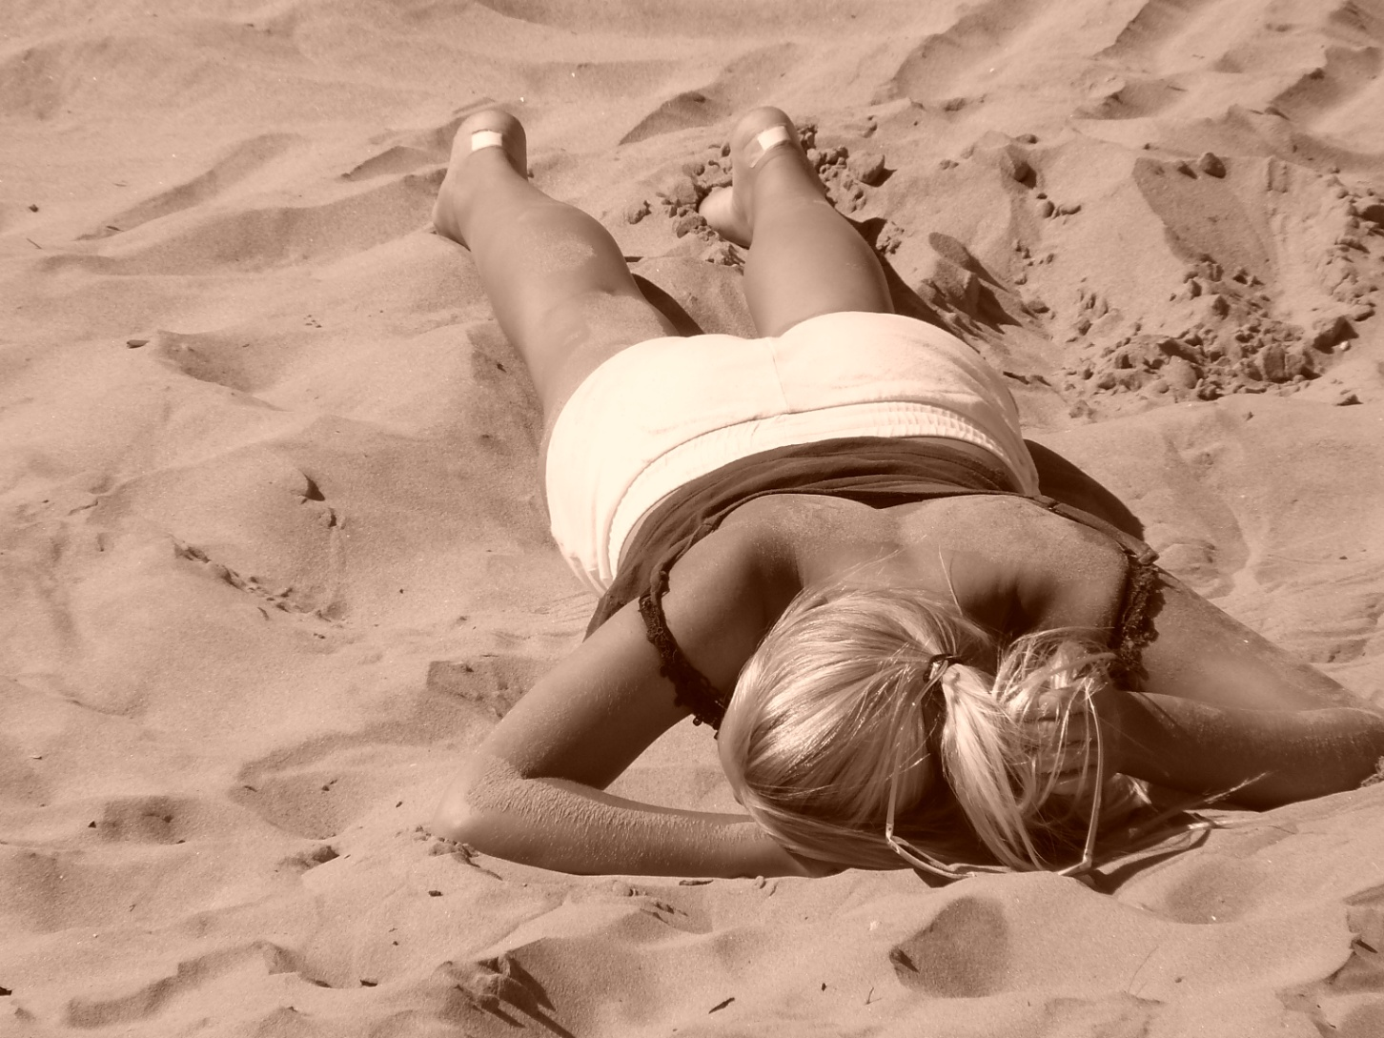
focal length 72mm, f7.1, shutter 1/400, exposure compensation 0

Slide 7
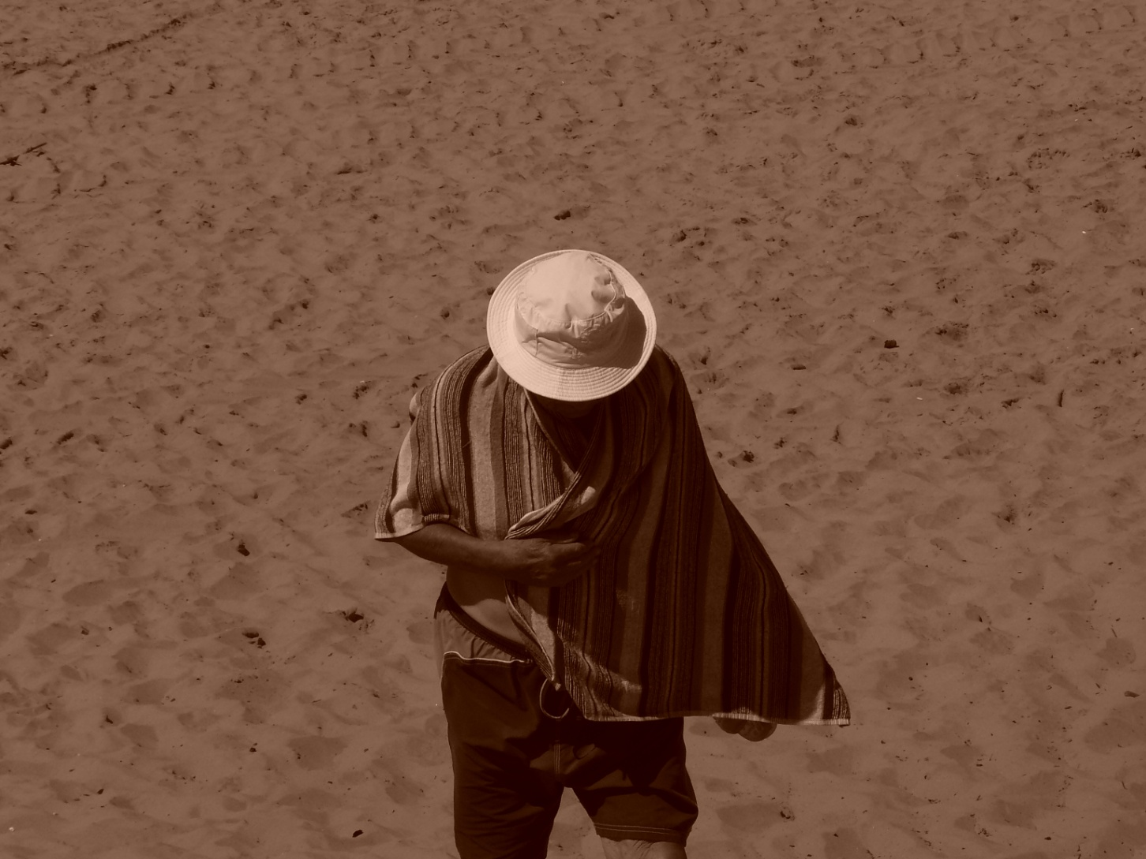
focal length 34.2mm, f8, shutter 1/1000, exposure compensation -1

Slide 8
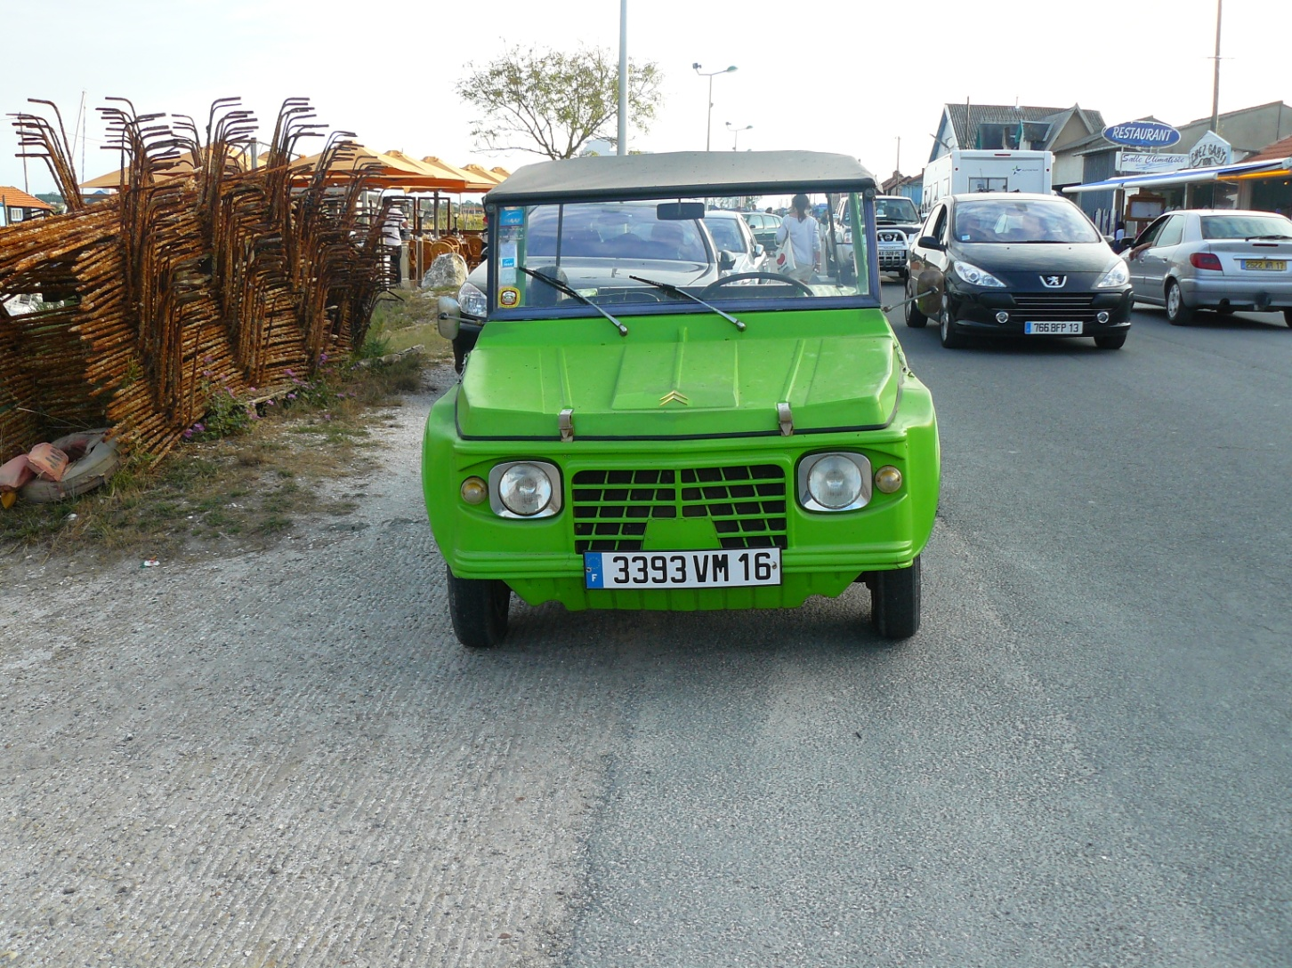
focal length 6mm, f4, shutter 1/125, exposure compensation 0

Slide 9
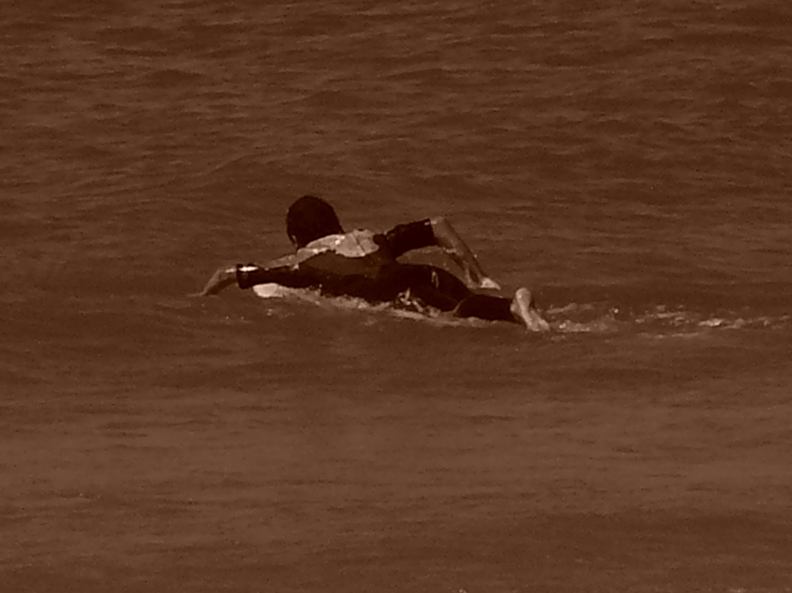
focal length 72mm, f8, shutter 1/640, exposure compensation -1

Slide 10
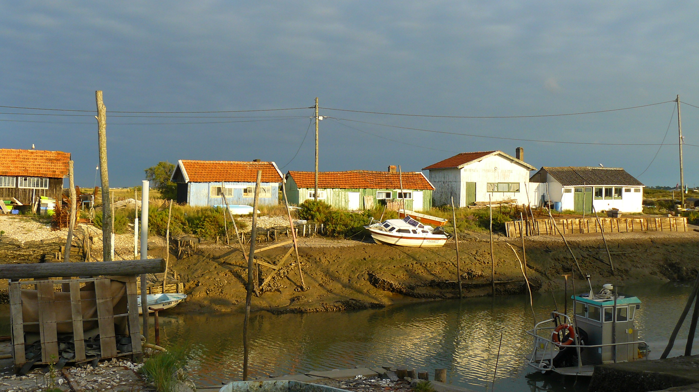
focal length 6mm, f4.5, shutter 1/250, exposure compensation 0

Slide 11
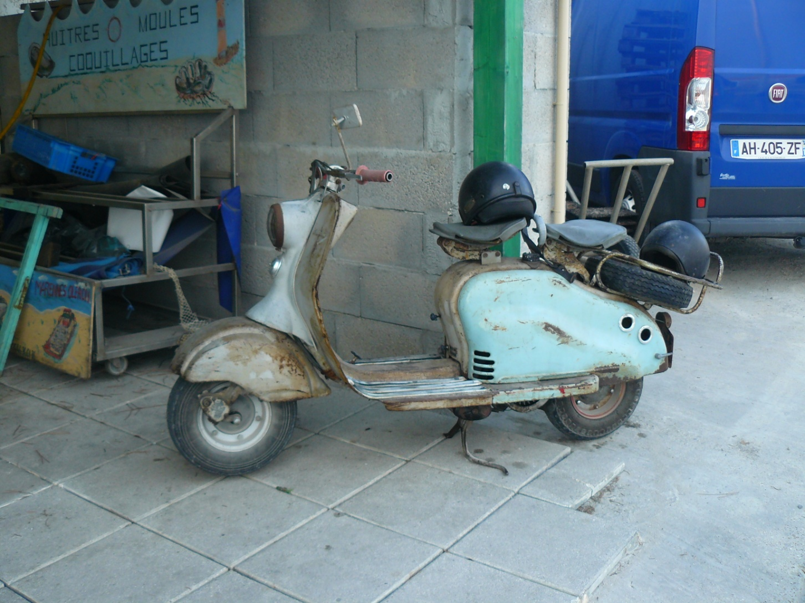
focal length 6mm, 2.8, shutter 1/80, exposure compensation 0

Slide 12
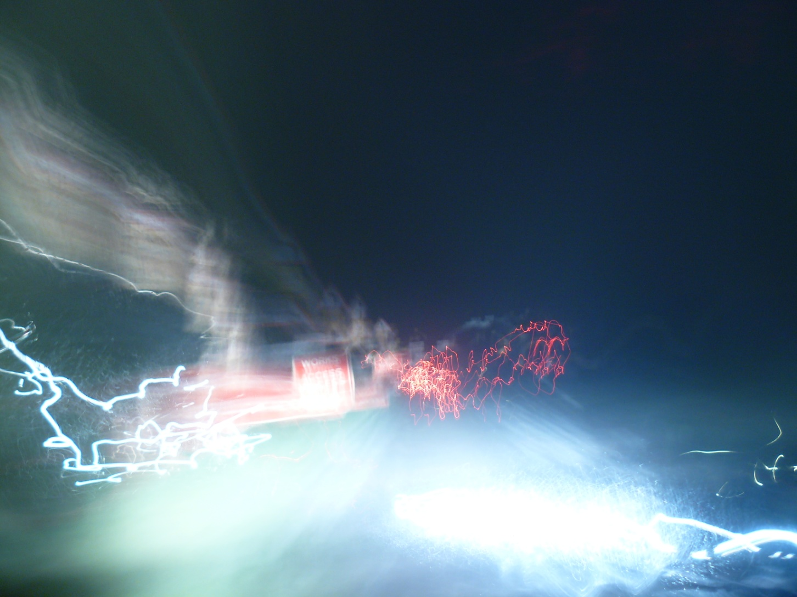
focal length 6mm, f2.8, shutter 40sec, exposure compensation 0

Slide 13
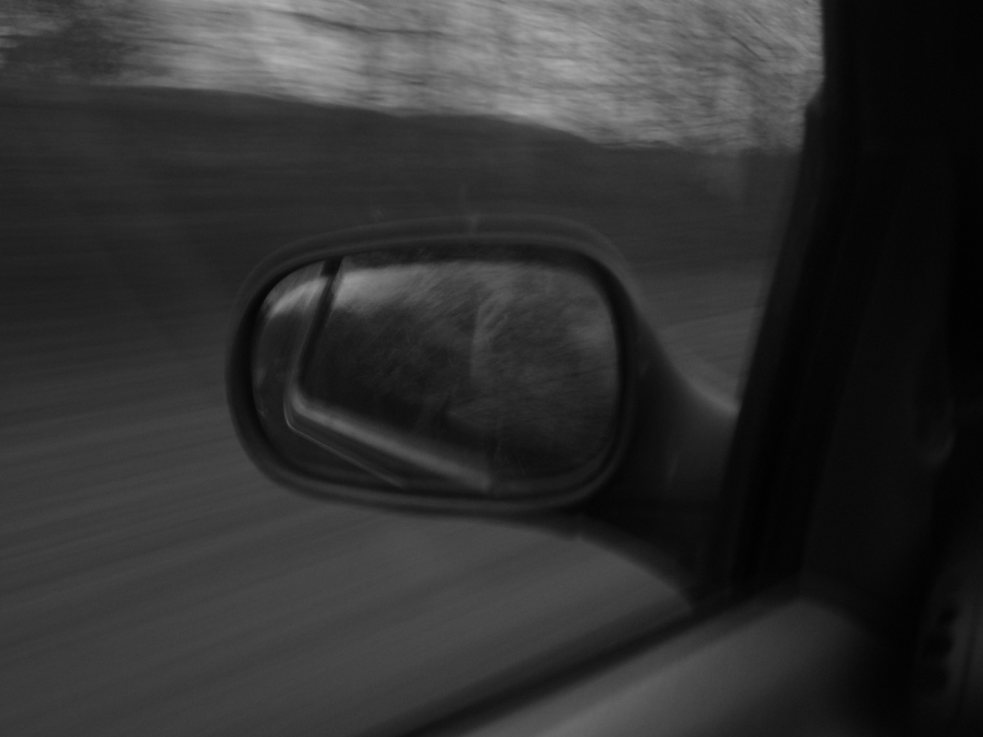
focal length 8.9mm, f2.8, shutter 1 / 4 sec, exposure compensation 0

Slide 14
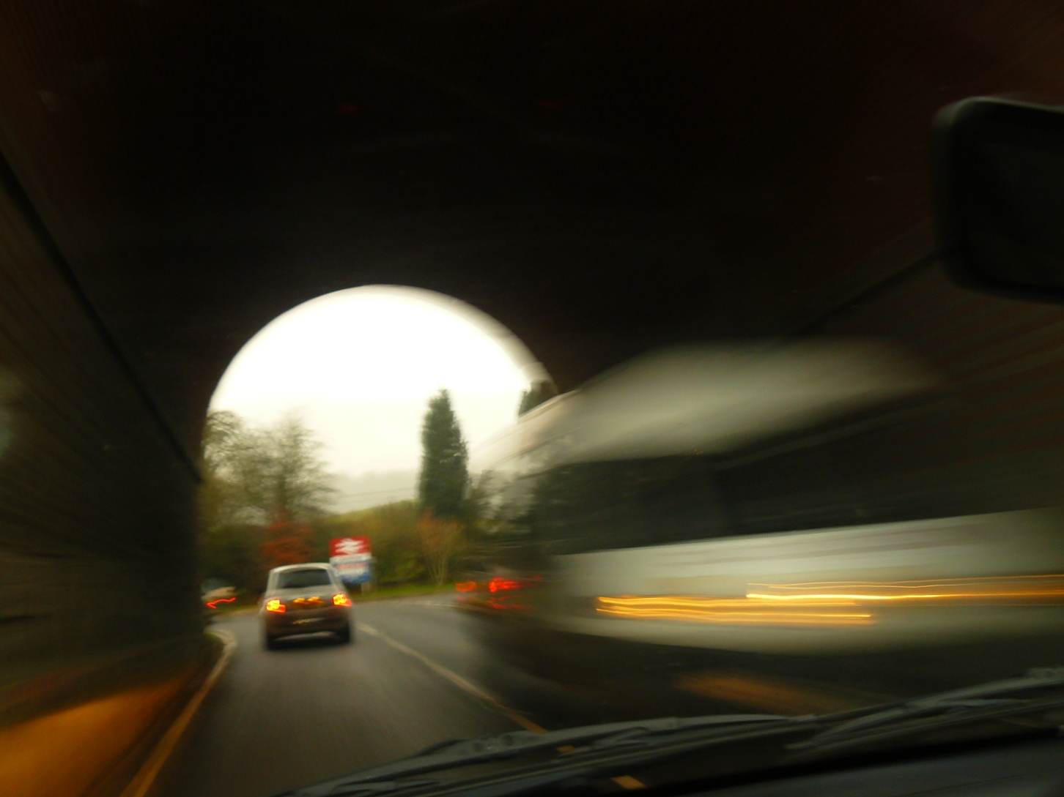
focal length 6.1mm, f3.2, shutter 1/5, exposure compensation 0

Slide 15
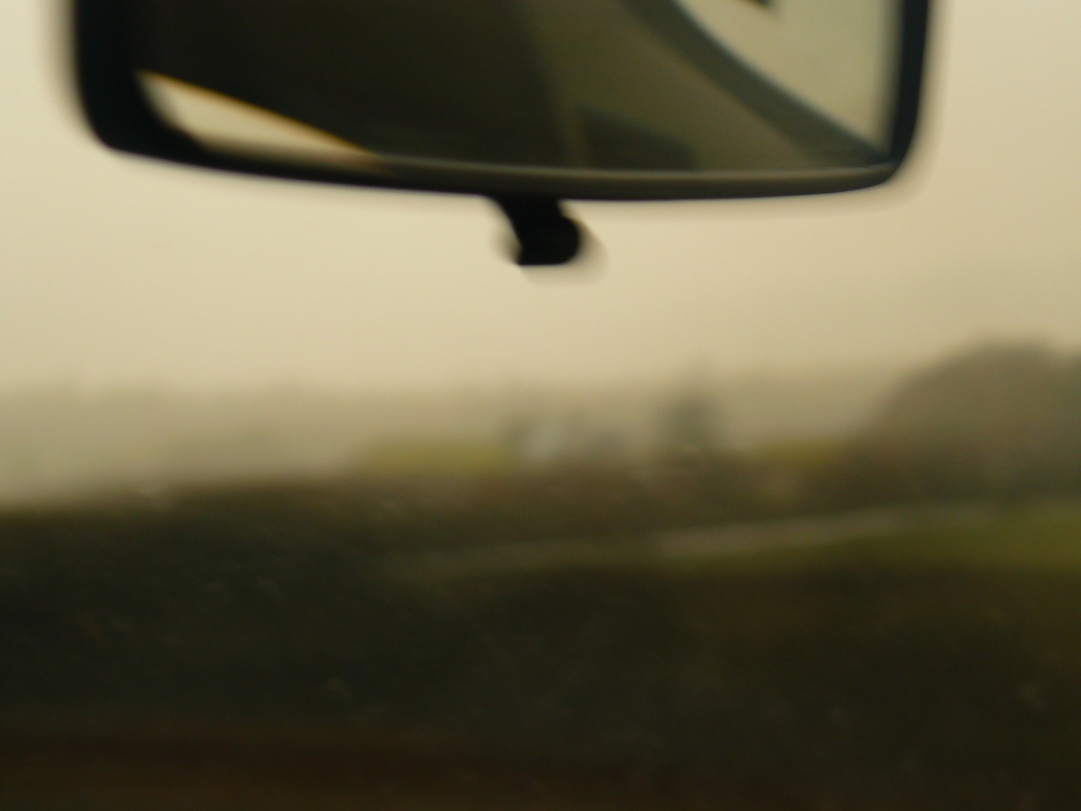
focal length 16.9, f3.2, shutter 1/13, exposure compensation 0

Slide 16
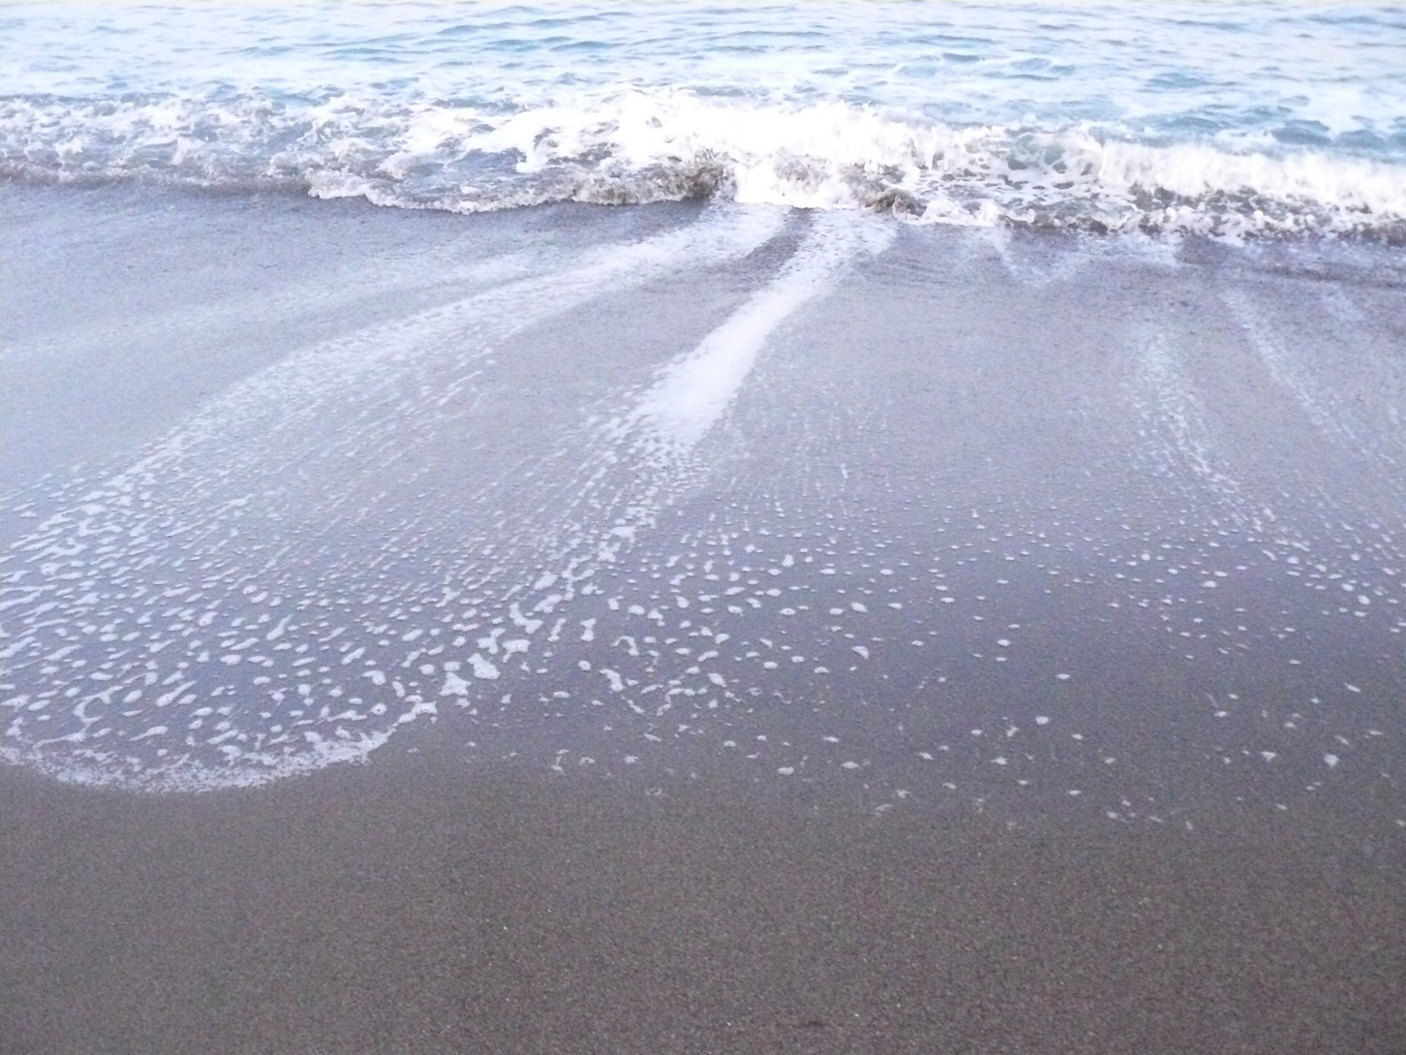
focal length 6mm, f2.8, shutter 1/125, exposure compensation 0

Slide 17
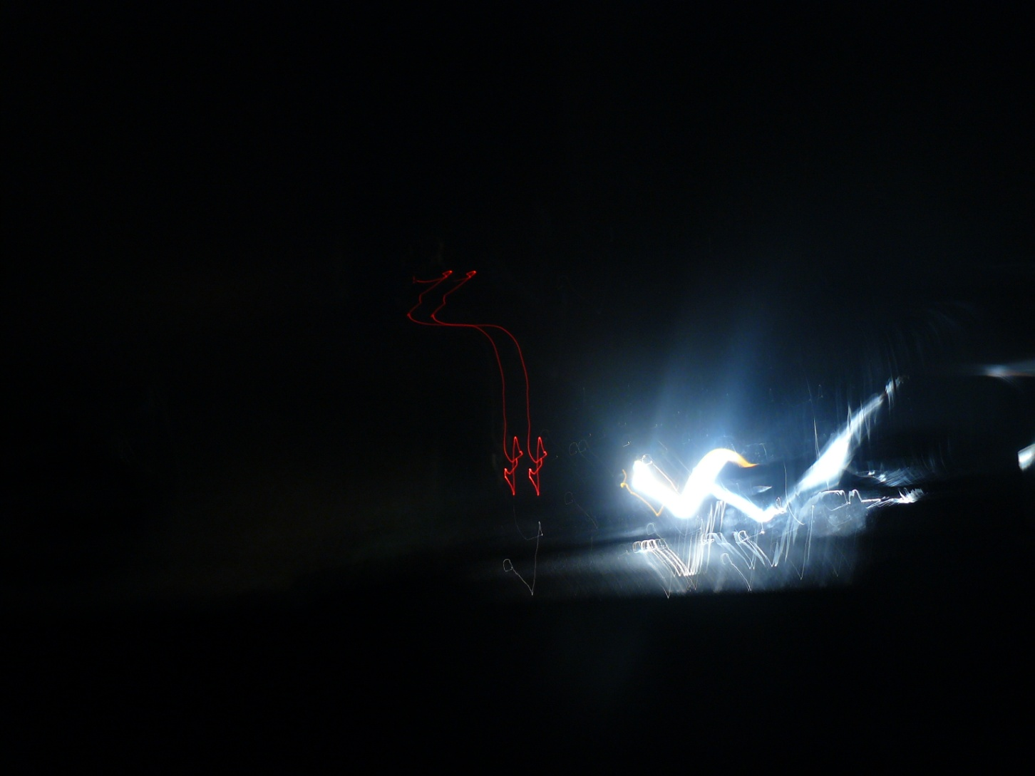
focal length 6mm, f2.8, shutter 1.3sec, exposure compensation 0

Slide 18
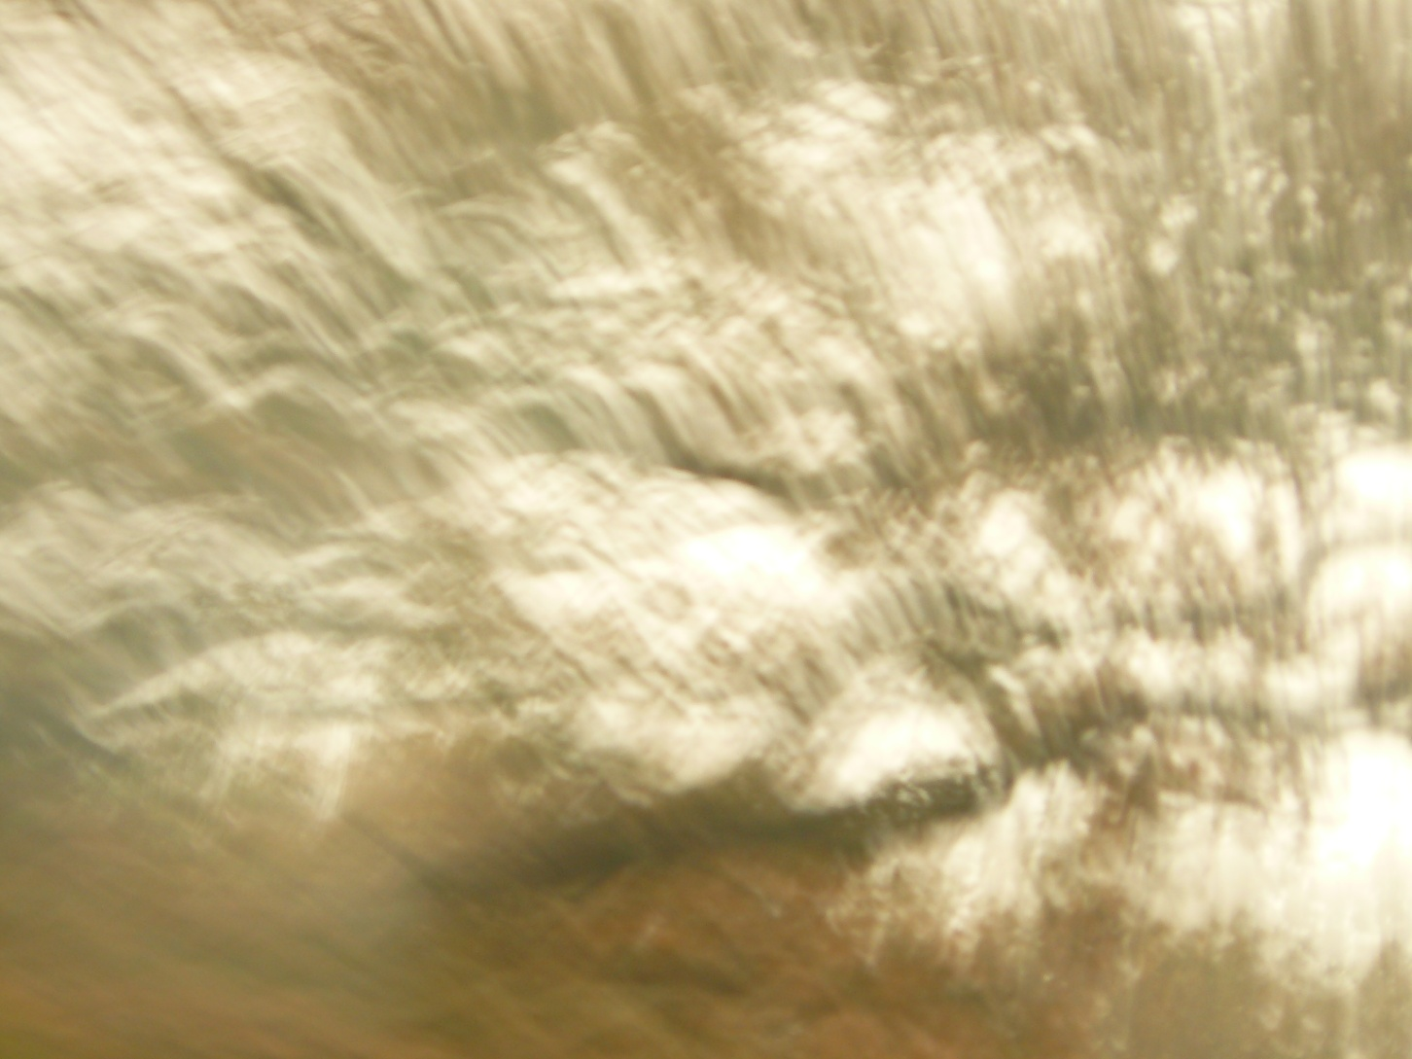
focal length 36.5mm, f3.3, shutter 5/16, exposure compensation 0

Slide 19
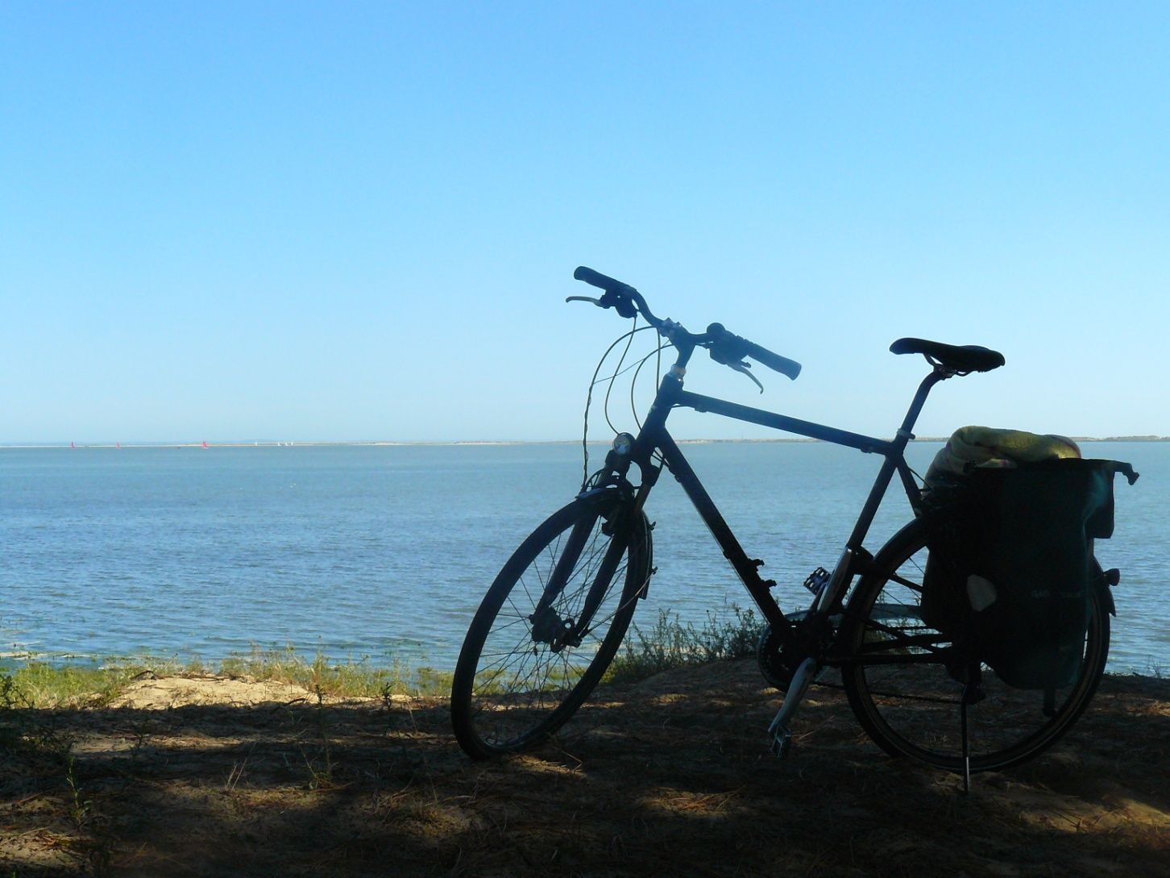
focal length 8.7mm, f7.1, shutter 1/400, exposure compensation 0

Slide 20
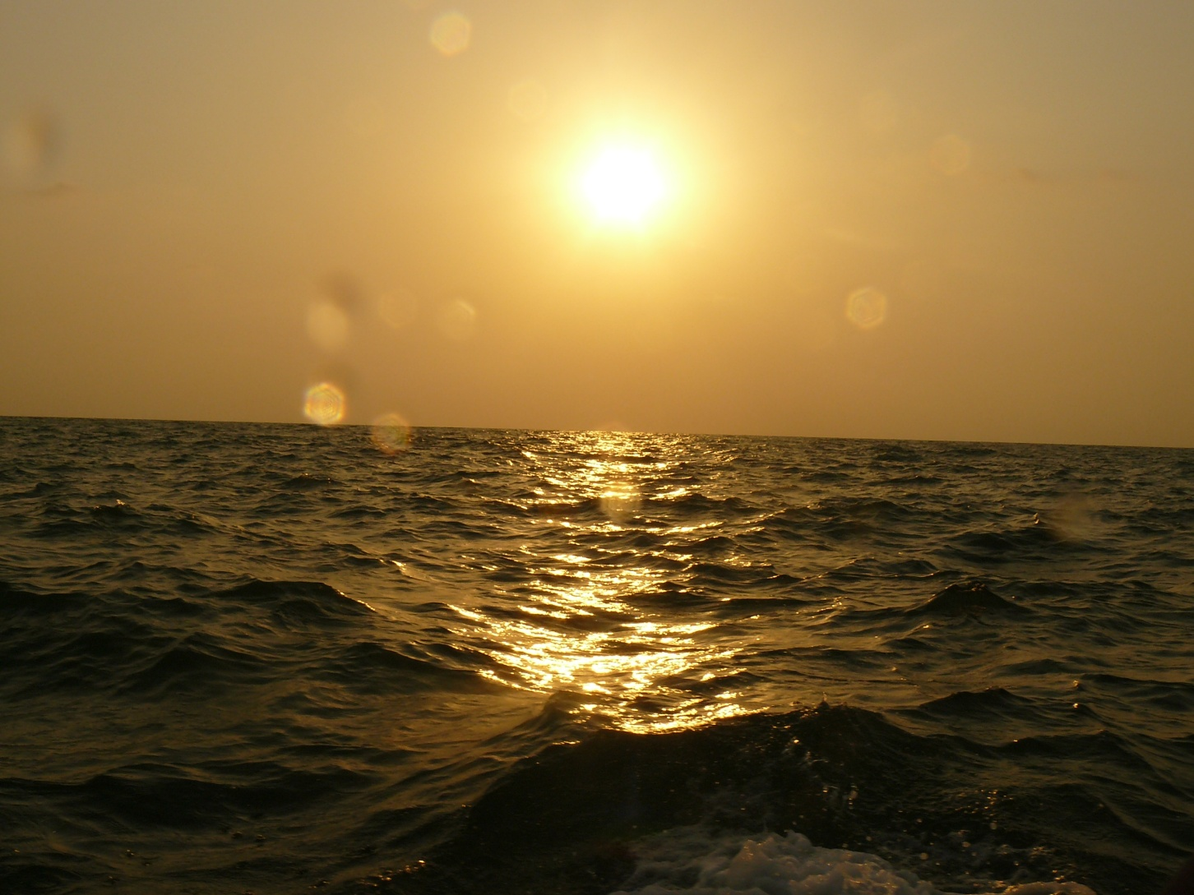
focal length 6mm, f8, shutter 1/800 sec, exposure compensation 0

Slide 21
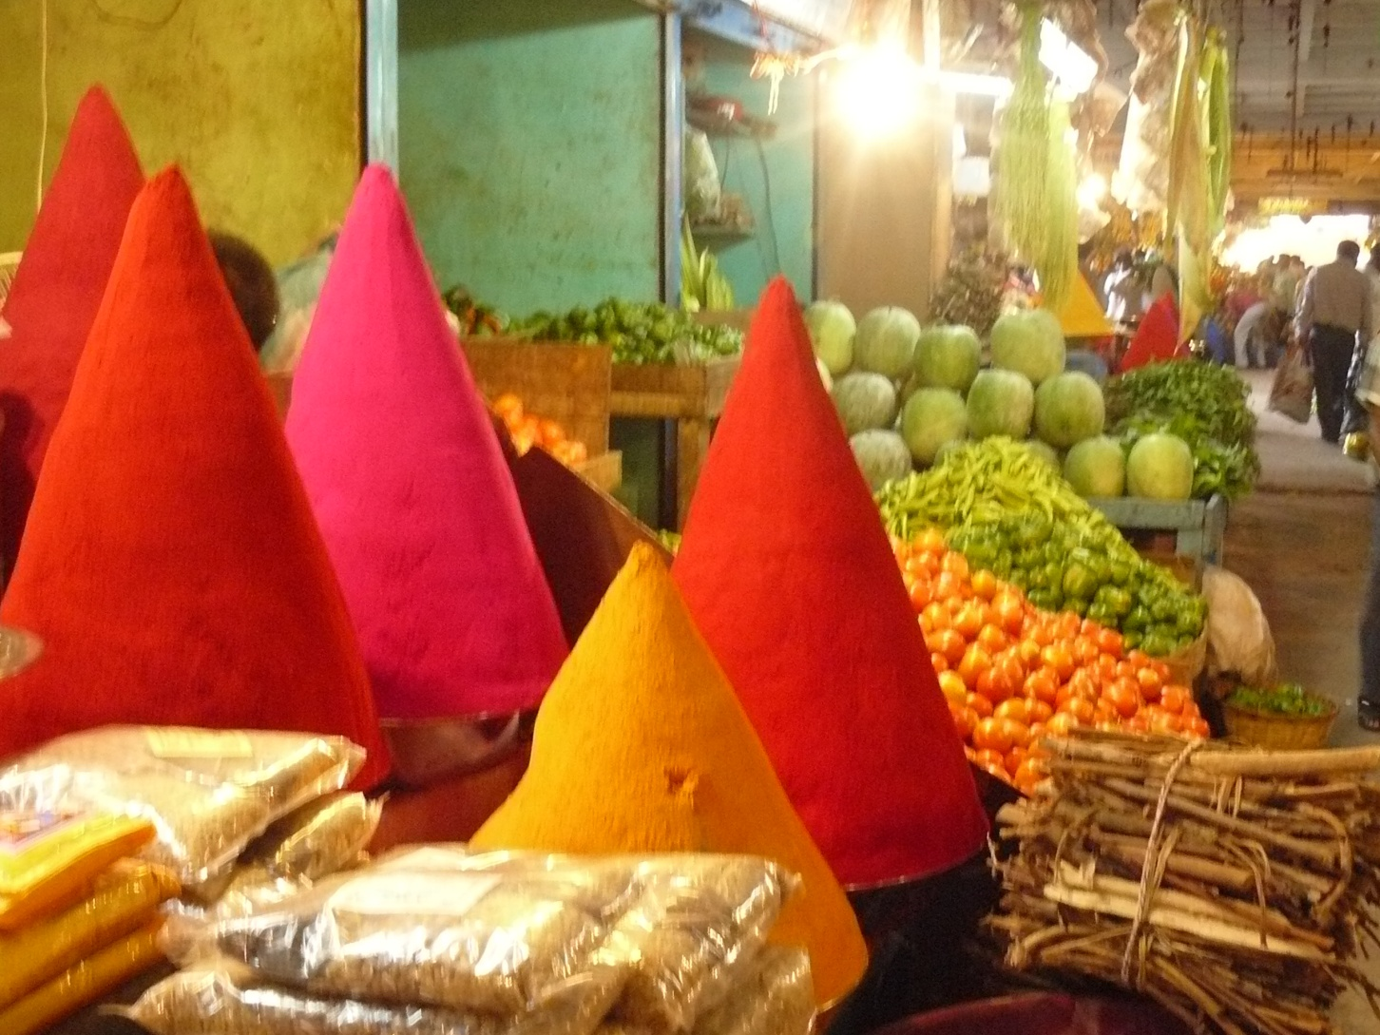
focal length 6.4, f2.8, shutter 1/13, exposure compensation 0

Slide 22
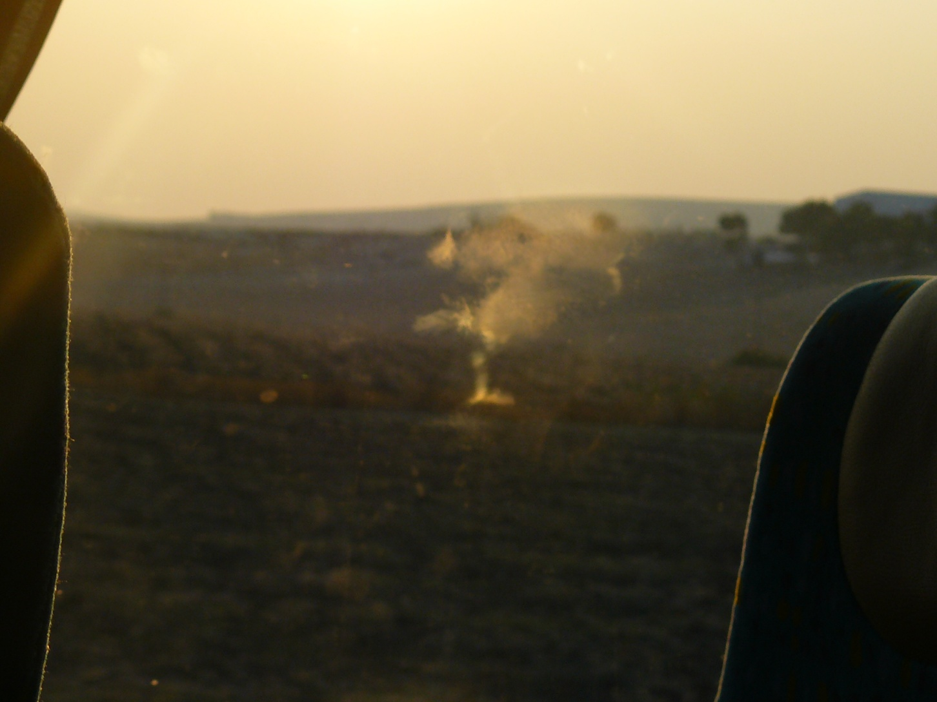
focal length 17.7mm, f4.5, shutter 1/200, exposure compensation 0

Slide 23
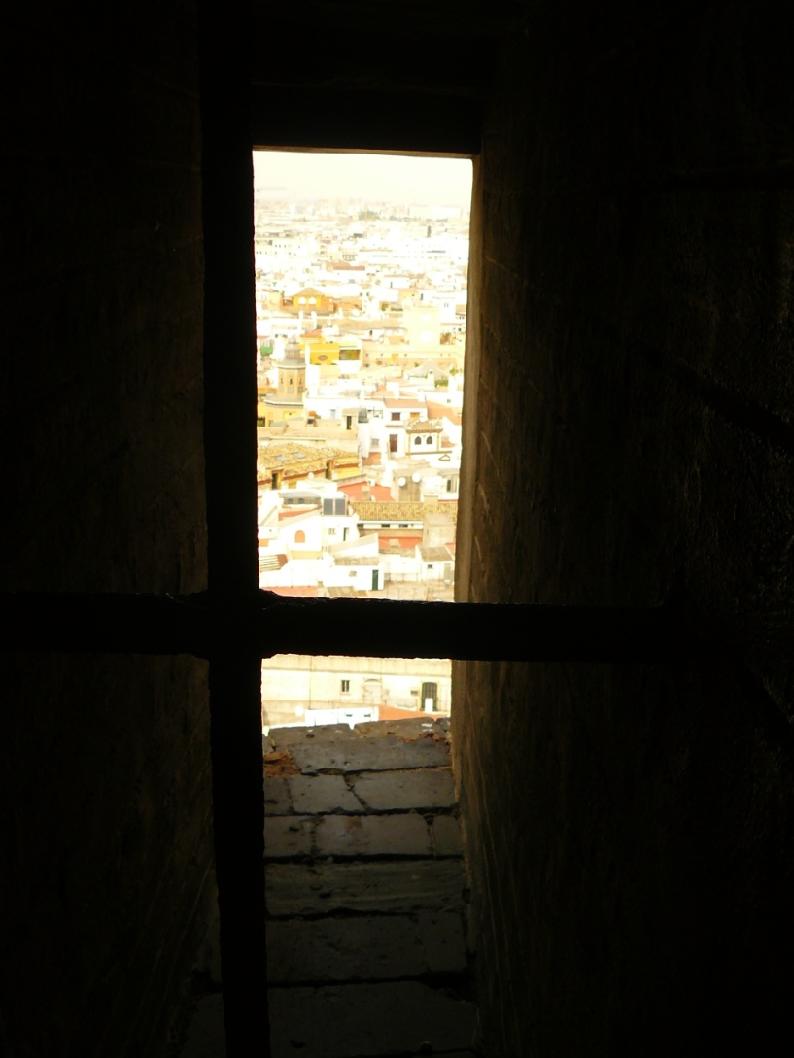
focal length 6mm, f4, shutter 1/250, exposure compensation 0

Slide 24
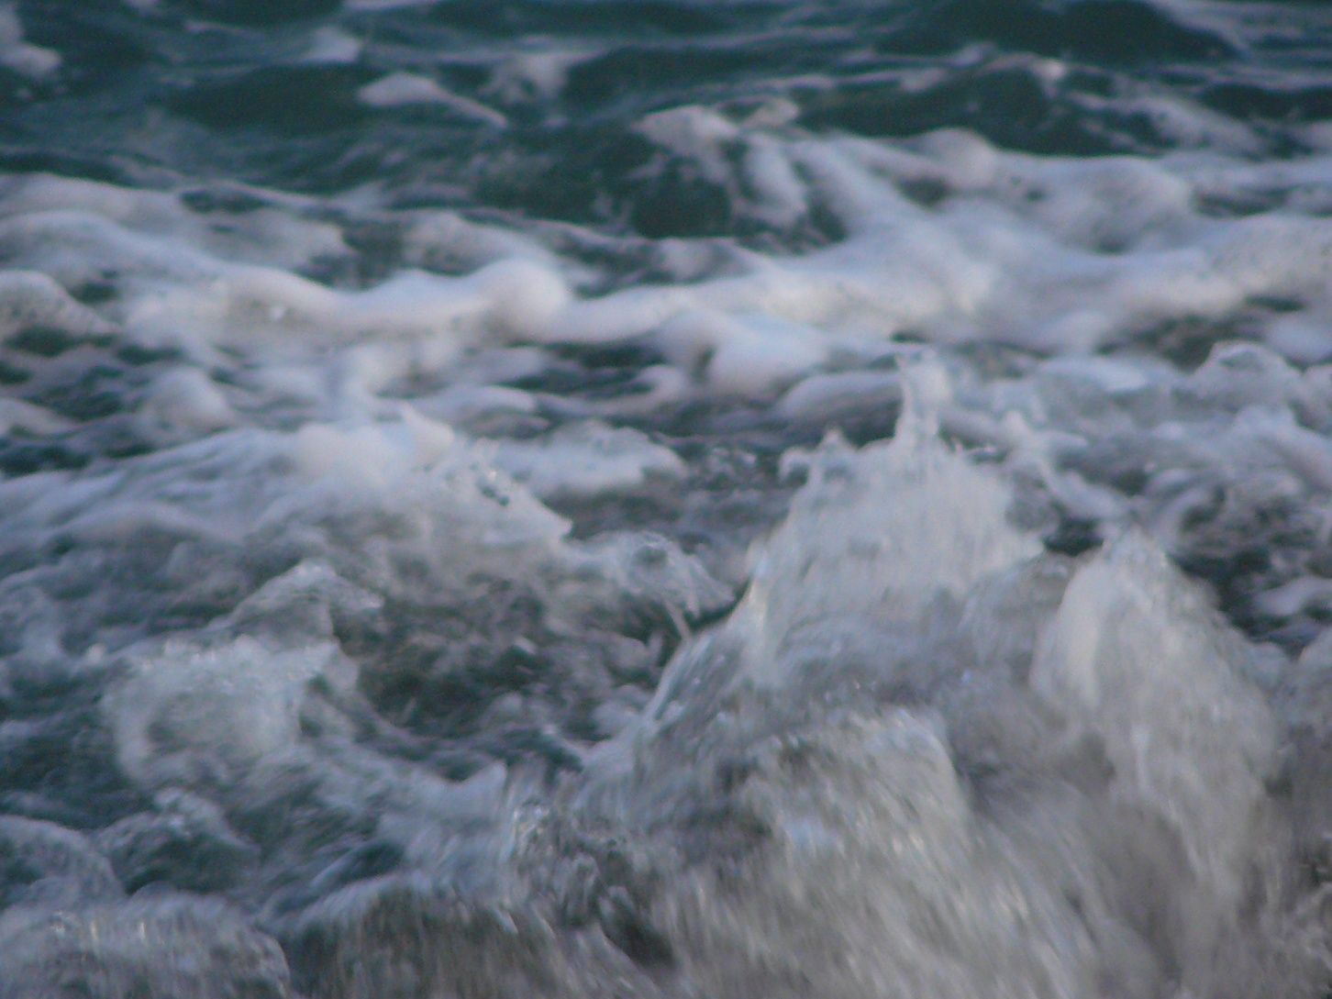
focal length 72, f3.3, shutter 1/125, exposure compensation 0

Slide 25
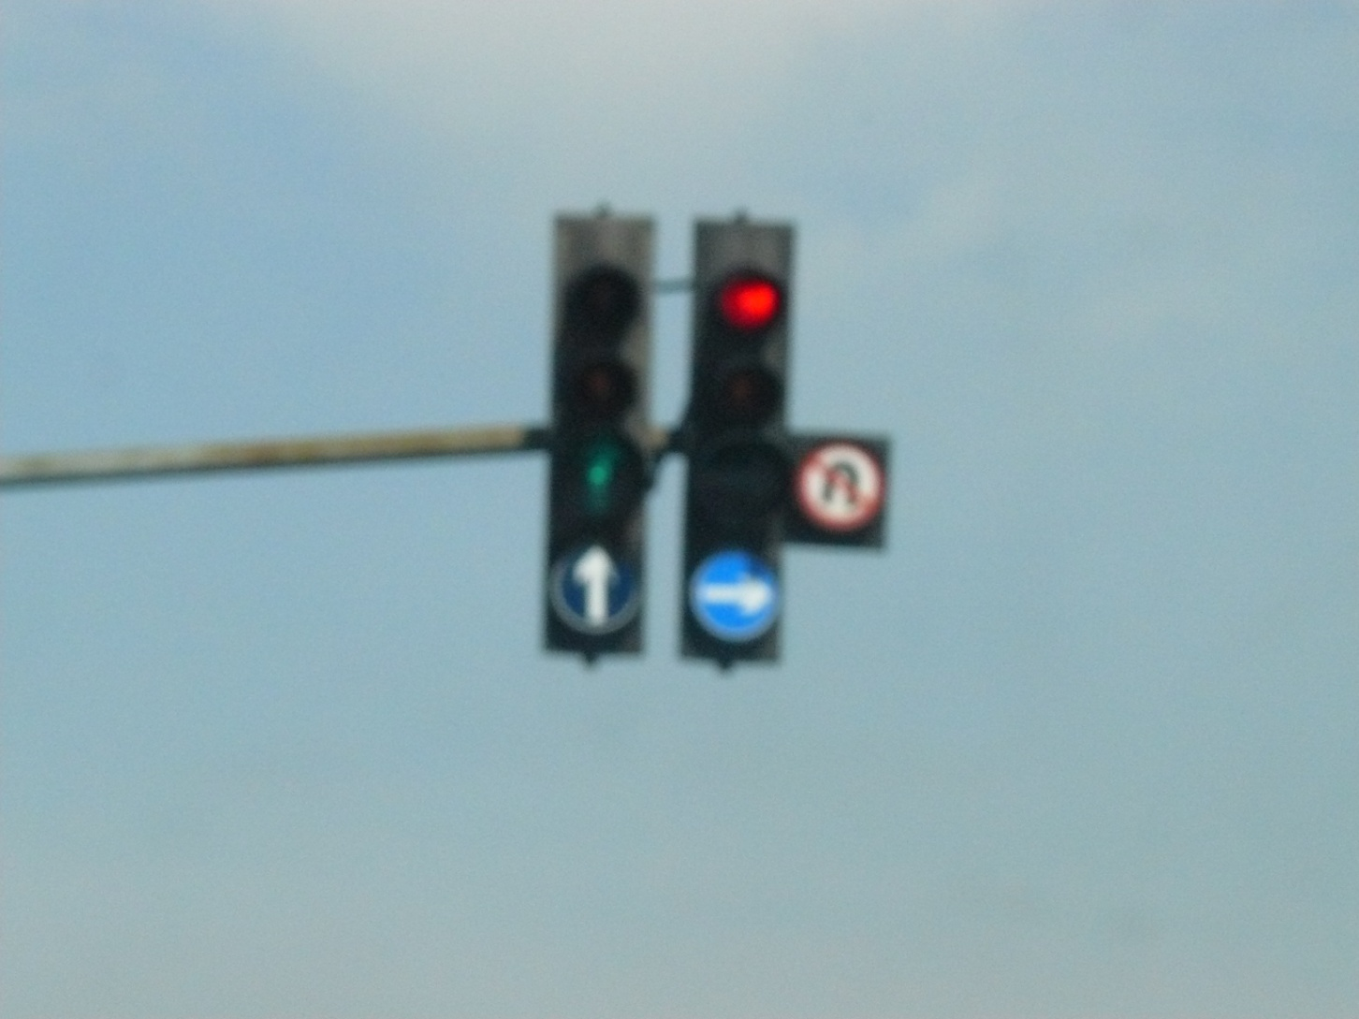
focal length 35.9, f8, shutter 1/800, exposure compensation 0

Slide 26
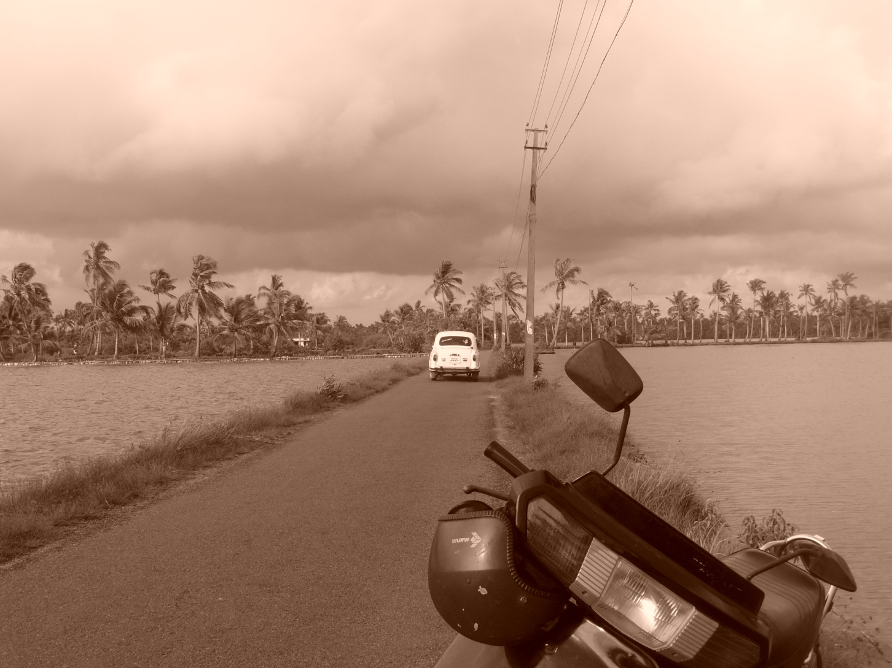
focal length 6mm, f5, shutter 1/250, exposure compensation 0

Slide 27
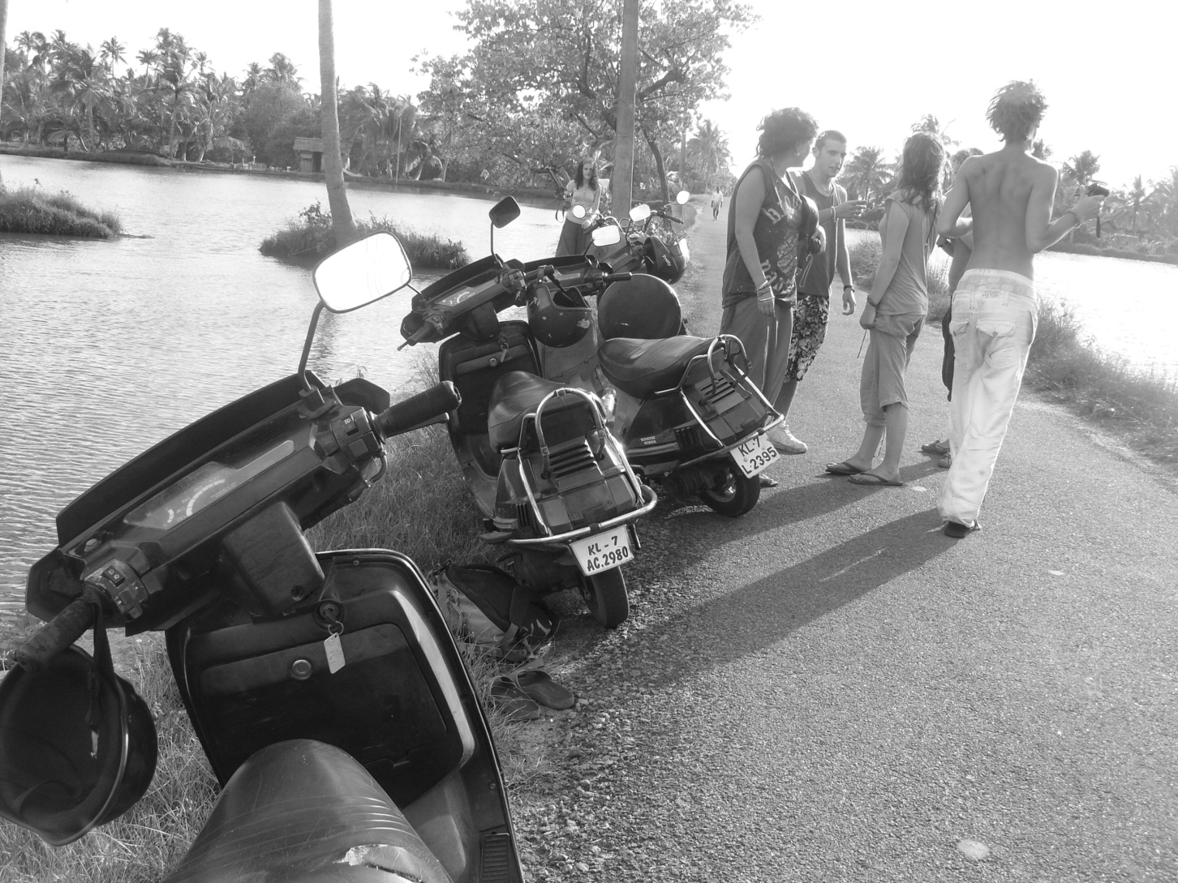
focal length 6mm, f4, shutter 1/200, exposure compensation 0

Slide 28
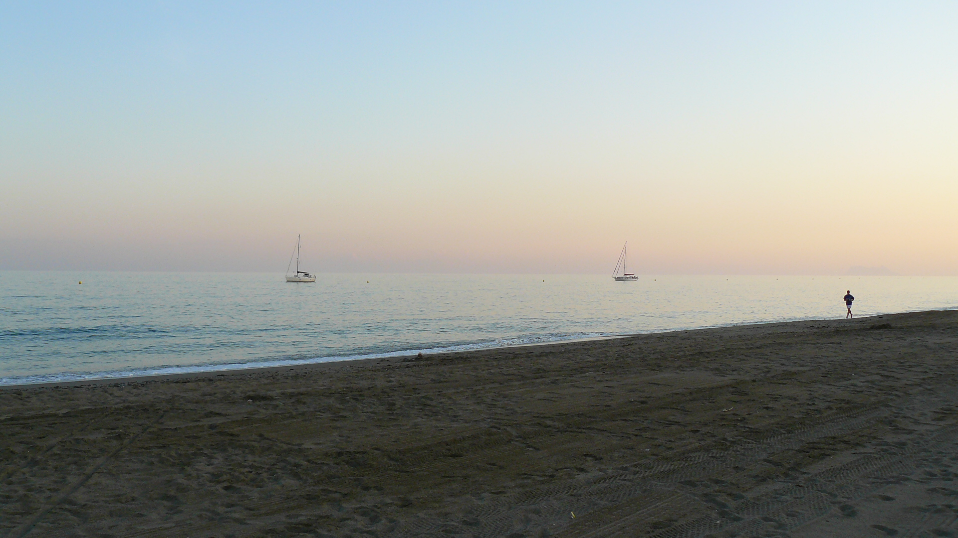
focal length 6mm, f4, shutter 1/100, exposure compensation 0

Slide 29
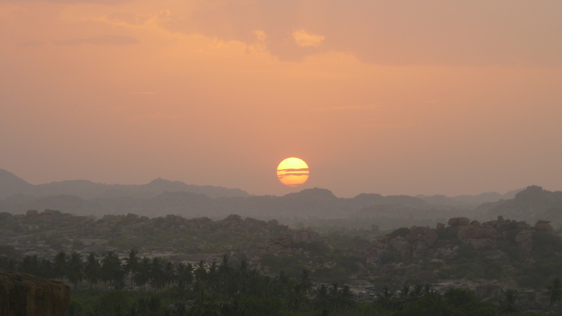
focal length 35.9mm, f3.3, shutter 1/80 exposure compensation 0

Slide 30
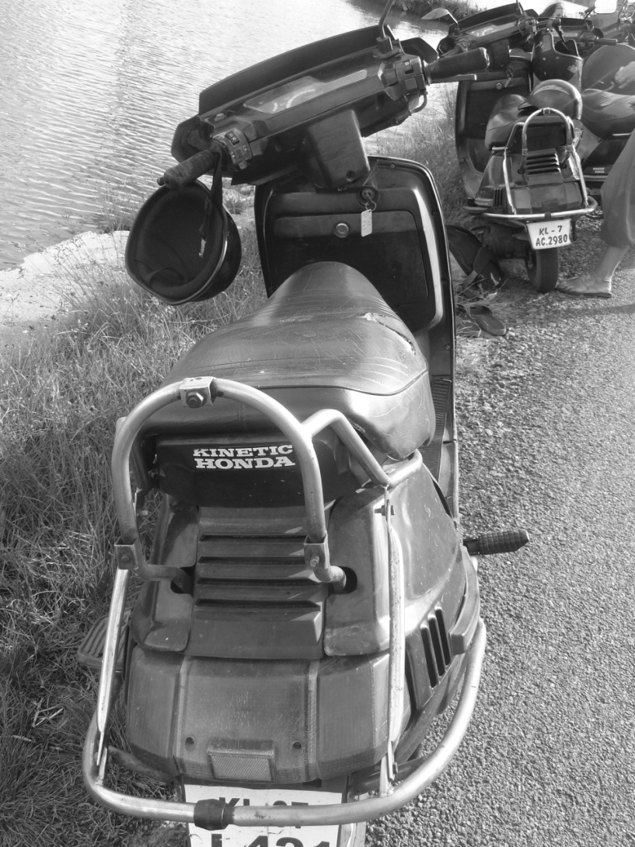
focal length 6mm, f4, shutter 1/125, exposure compensation 0

Slide 31
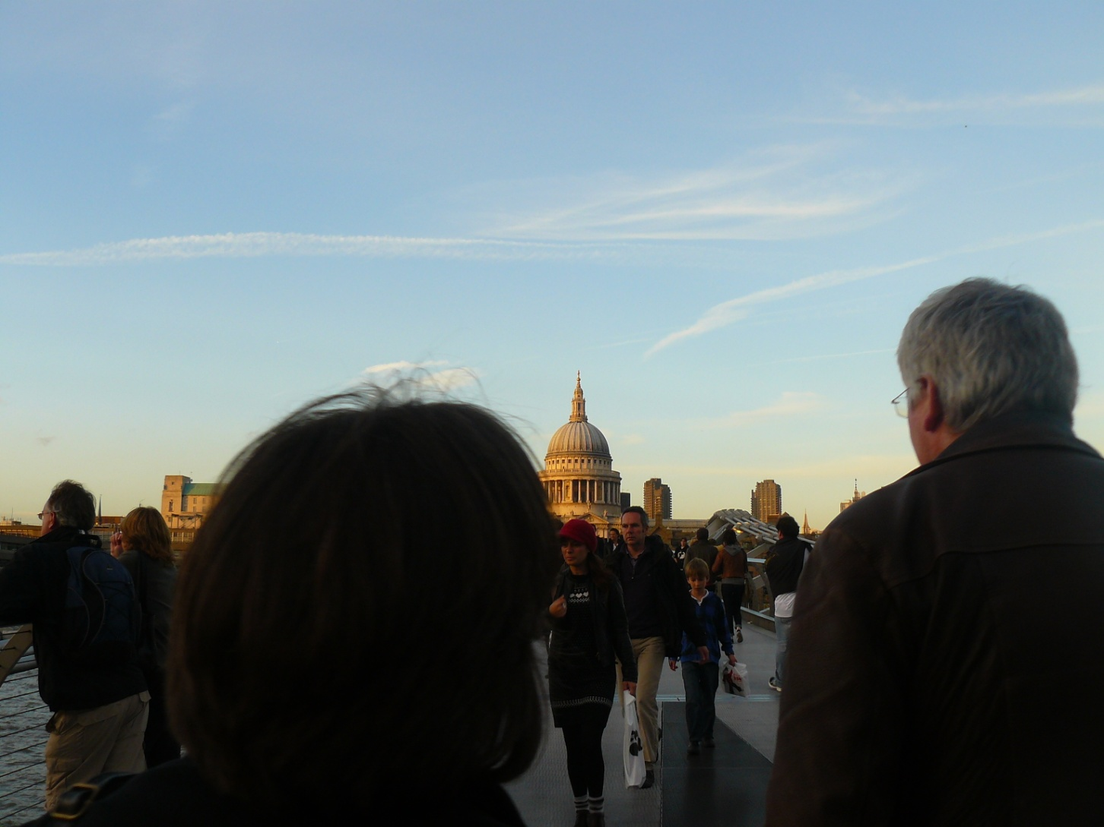
focal length 6mm, f4, shutter 1/125, exposure compensation 0

Slide 32
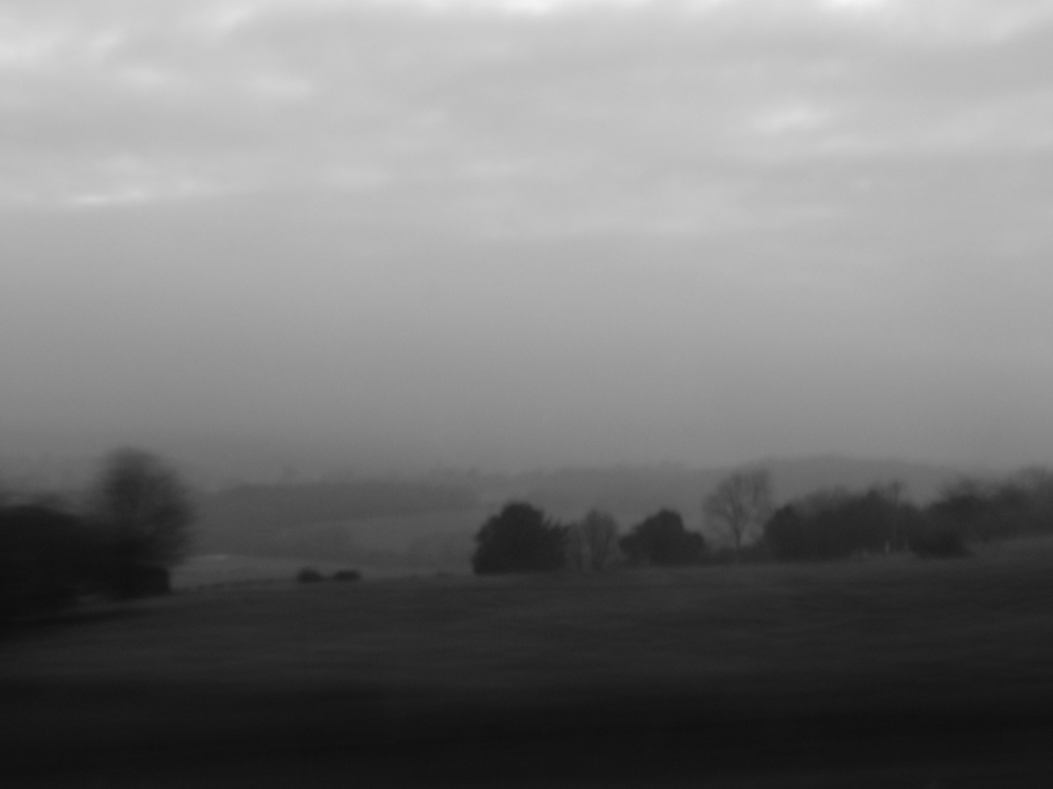
focal length 7.6mm, f4, shutter 1/10, exposure compensation 0

Slide 33
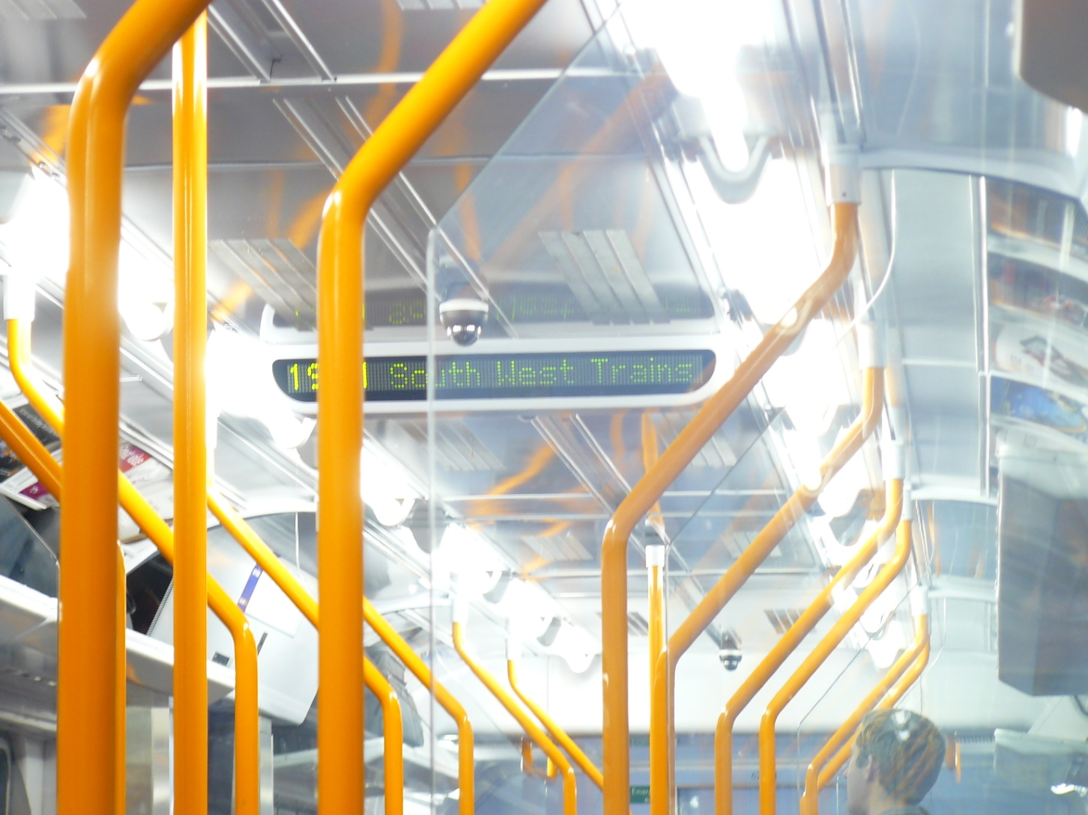
focal length 25.1mm, f 3.3, shutter 1/6, exposure compensation 0

Slide 34
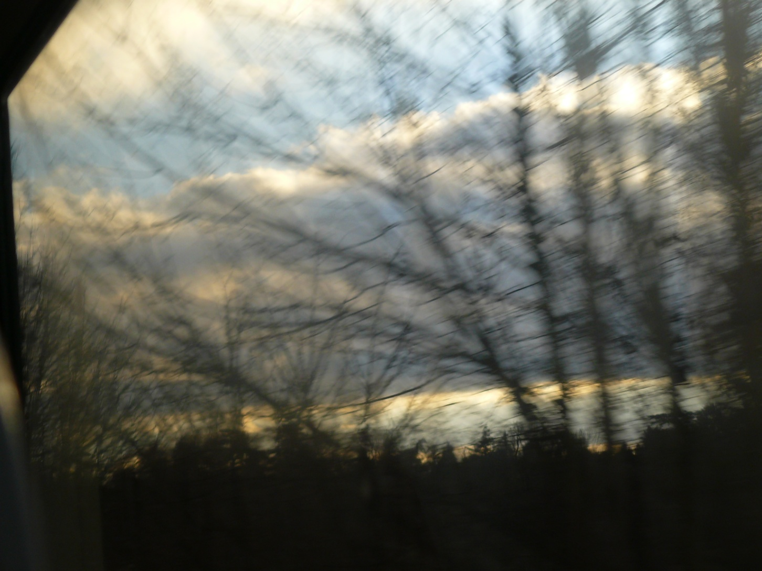
focal length 16.9, f3.2, shutter 1/125, exposure compensation 0

Slide 35
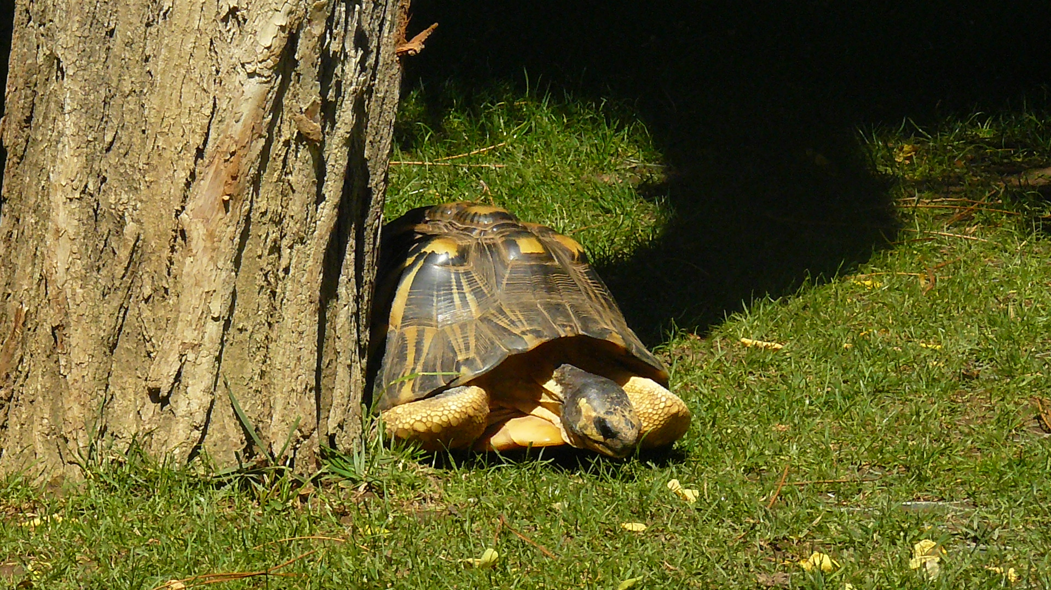
focal length 24.1mm, f7.1, shutter 1/400, exposure compensation -2/3

